Slide 1


Powered By Altair
RapidMiner Studio
Credit Risk
Analysis
Stanley A
Loyola ICAM College Of Engineering and Technology

Slide 2

Introduction
In today's financial landscape, the ability to assess credit risk accurately is paramount for banks.
In this project, we aim to develop a predictive model using RapidMiner, a powerful data science platform, to assess credit risk for loan applicants.
Project Overview
Credit risk analysis is the means of assessing the probability that a customer will default on a payment before you extend trade credit.
Followed based on 2 Values-
Good and Bad
Dataset taken from
RapidMiner Studio
RapidMiner Studio is a visual workflow designer that makes data scientists more productive, from the rapid prototyping of ideas to designing mission-critical predictive models.

Slide 3




Objectives
Traditional methods of risk assessment often rely on manual processes and limited data, leading to inefficiencies and suboptimal outcomes.
Import and preprocess the dataset to handle missing values, encode categorical variables, and normalize numerical features.
Explore the dataset to gain insights into the underlying patterns and relationships between variables.
Validate the final model using cross-validation techniques to ensure its generalization performance.

Slide 4

Improved accuracy and efficiency in credit risk assessment.
01
02
Reduction in loan default rates and associated financial losses.
Benefits
03
Enhanced decision-making process for loan approvals, leading to better customer satisfaction.
04
Automation of manual processes, resulting in cost savings and operational efficiencies.

Slide 5



Attributes Used
Age & Sex
Job
Age Range :
19 to 75
Sex Values :
Male and Female
0 - unskilled and non-resident
1 - unskilled and resident
2 - skilled
3 - highly skilled
Housing & Duration
Savings & Checking Account
Housing Attributes :
Own , Rent, Free
Duration Period:
Value in Months
Saving Attrbutes:
Little, Moderate, Quite Rich, Rich
Checking Attributes:
Value in DM
Purpose
Risk
Values are
car, furniture, radio/TV, business, vacation/others
Values are -
Good and Bad

Slide 6
Building
Model

Slide 7
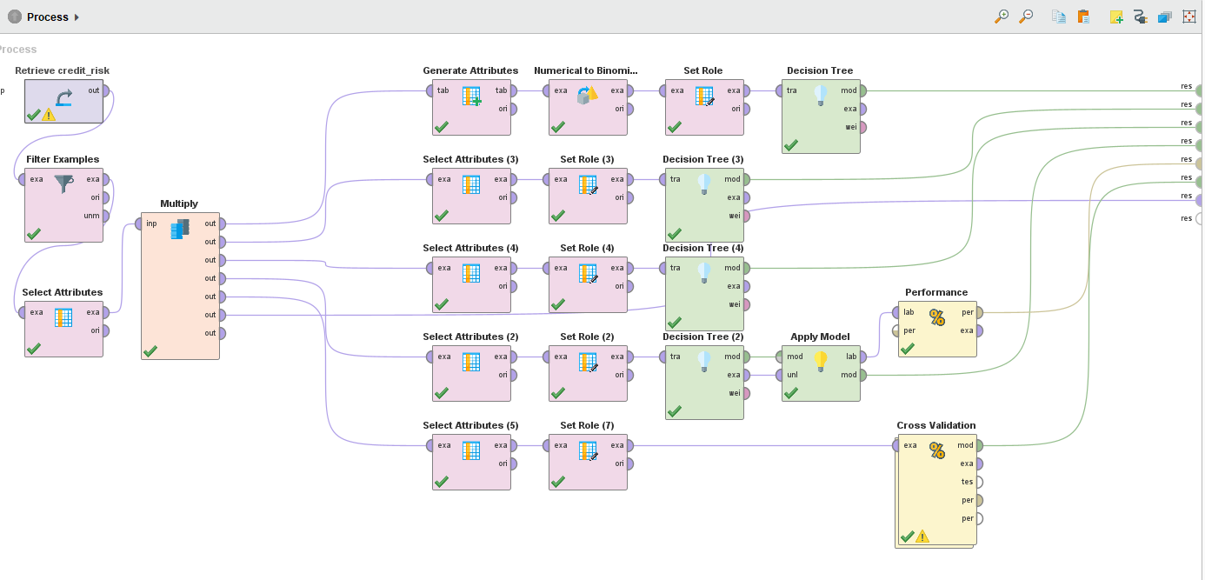
Preprocess Panel
A model built in preprocess panel with displaying various decision trees along with validation using performance.

Slide 8
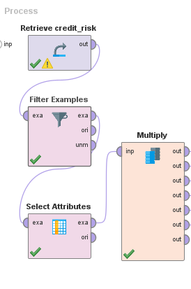
Cleansing Process
This process involves
Removing rows with value as NA
Selecting only the wanted attributes ( excludingcolumn 1)

Slide 9
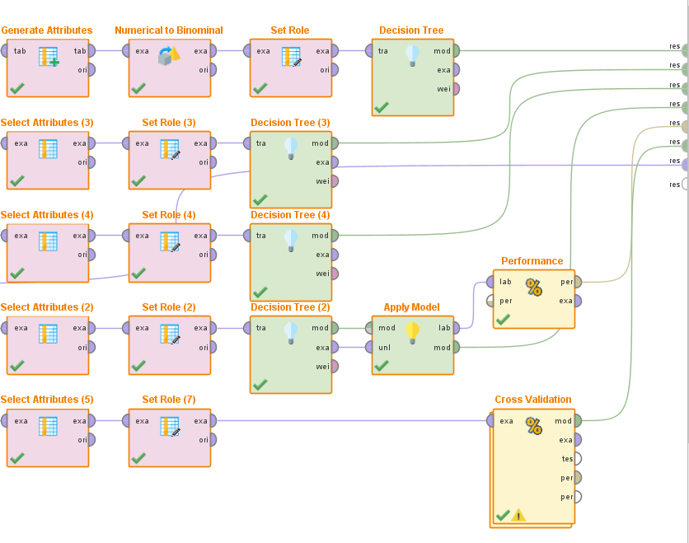
Model Usage
Decision Trees
Here multiple seperate decision trees are built for various differed attributes with RISK as Label in most cases
Validation
Cross Validation and Performance operators are used to Validate our Model with percentage of 56.70% +/- 1.91% (micro average: 56.70%) and 58.62%

Slide 10
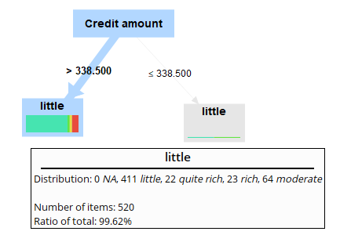
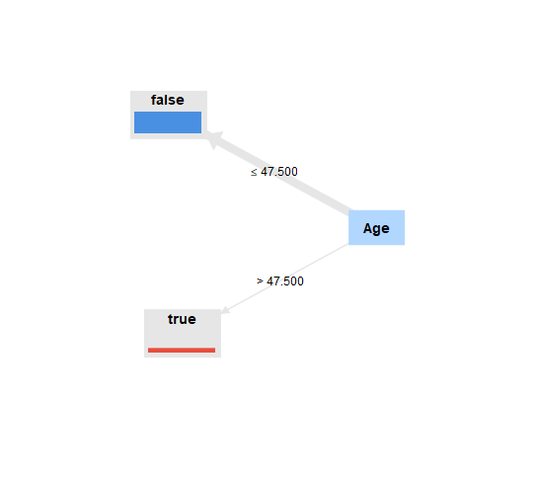
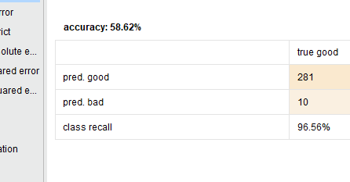

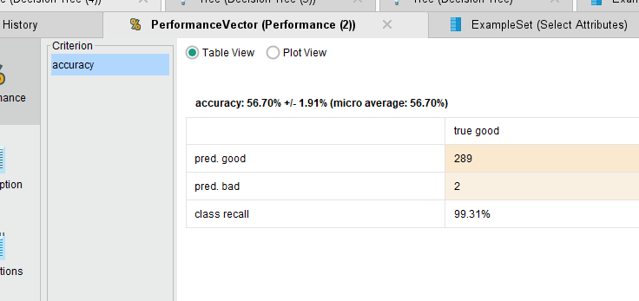
Ouput
Decision Tree 1
Decision Tree 2
Performance 1
Performance 2

Slide 11
Inference

Slide 12
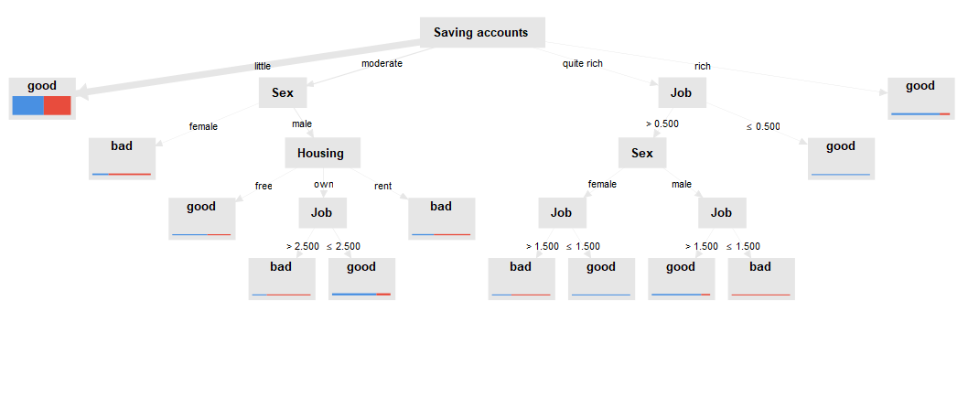
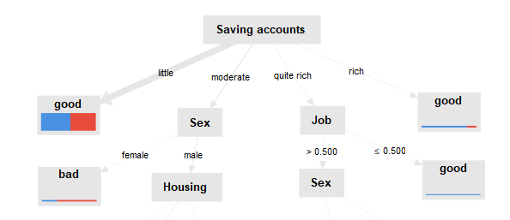
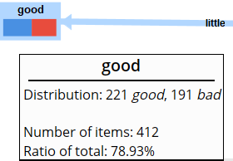
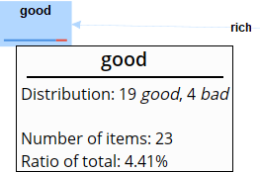
Decision Based on Savings Accounts
There are varios predictions made till the end but the most important part was:
Among rich - most(19) have good risk and (4) have a bad risk
Among little - about(221) have a Good risk and (191)have a Bad risk
Among moderate - further classified based on Sex
Among quite rich - further classified based on Job

Slide 13
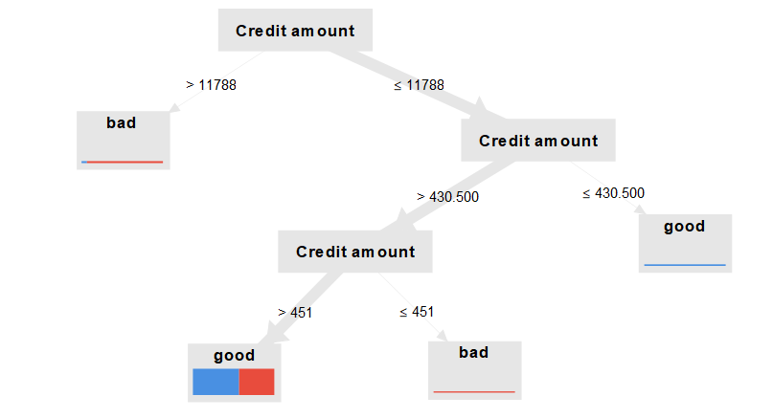
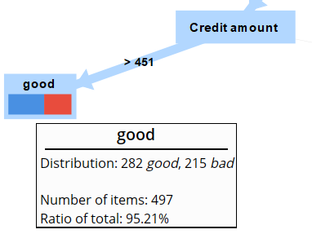
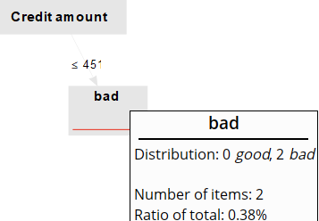
Decision Based on Credit Amount
This Tree clearly shows that :
Most of the one’s with credit amount more than 11788 have been a Bad Risk Factor
The lesser Credit Amount also varies majorly on the amount

Slide 14
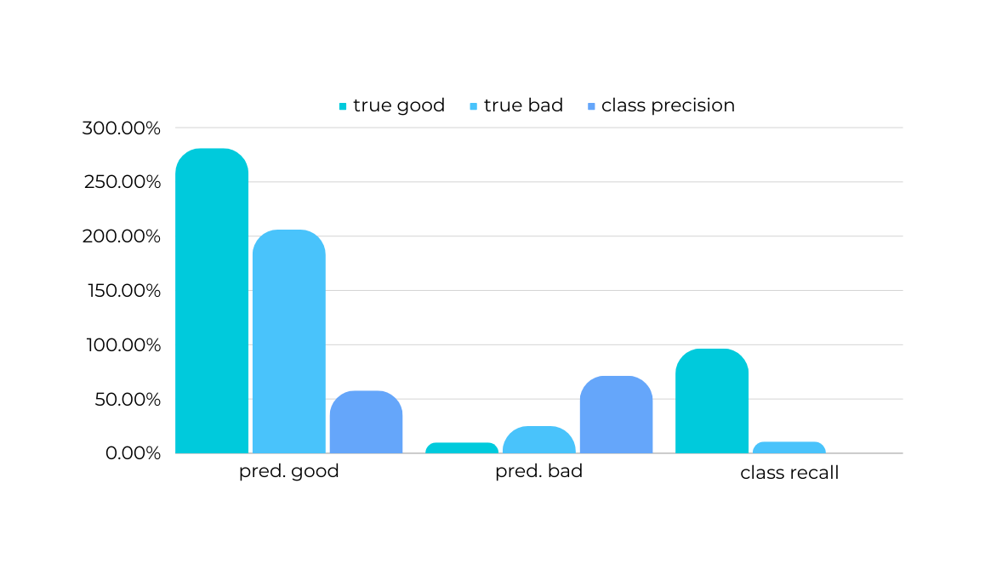
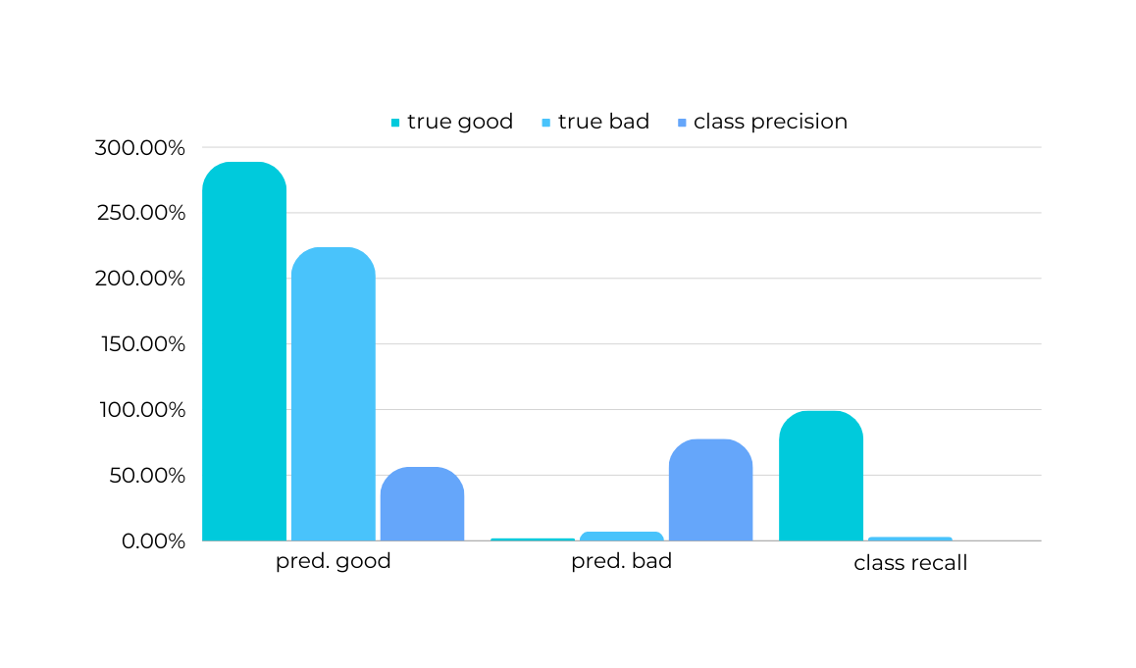
Based On Performance
Performance & Cross Validation
Both of the charts may be resembling same but the properties slightly vary like:
For performance:
accuracy: 58.62%
For cross-validation:
accuracy: 56.70% +/-
1.91%(micro average: 56.70%)
Based On Cross Validation

Slide 15
Visualizations

Slide 16
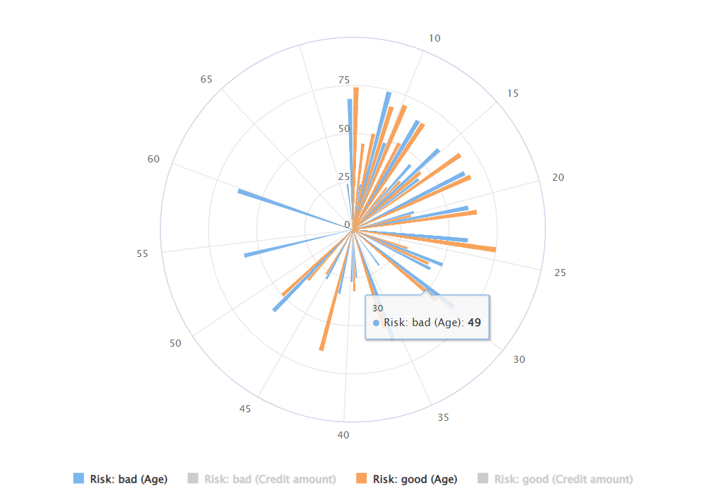
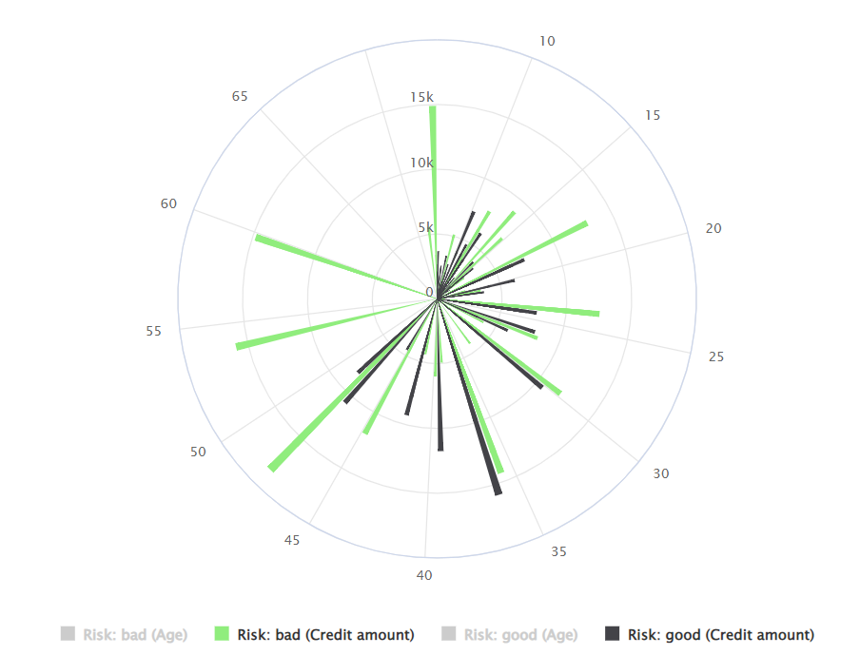
Analysis
AGE
CREDIT AMOUNT
This visualizations may stay simple but they focus simultaneously on 4 Major Attributes
DURATION
RISK
From Diagram:
1.Outer Ring represents the Duration in Months
2.Blue and Orange in Fig 1 shows the Bad and Good regarding Age
3.Green and Black in Fig 2 shows the Bad and Good regarding Credit Amount
4. Inner Ring represents Credit amount
Easy Inference:
1.Bad risk(Blue and Black) occurs more as Duration increases
2.Good risk is most at inner most circle where Credit Amount is less

Slide 17




Thank you
Contact Us
Stanley A
Student - Loyola ICAM
9941127755
stanley.25it@licet.ac.in

